Slide 1
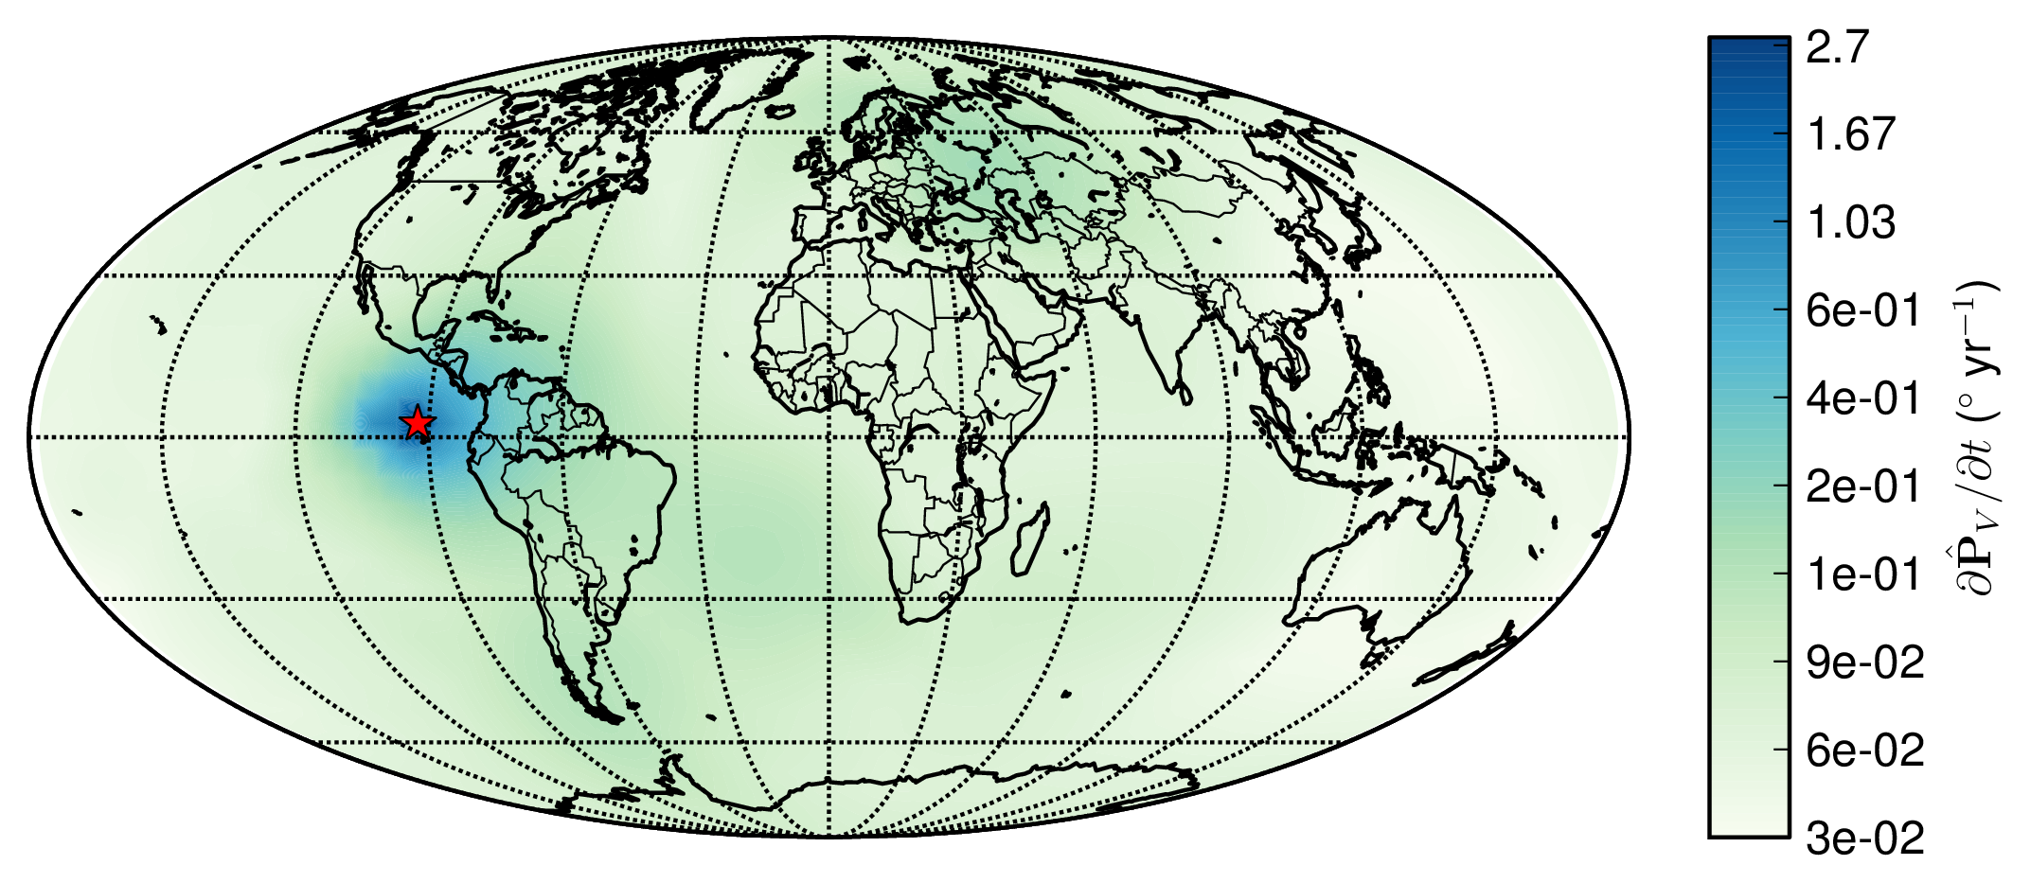



Rapid Geomagnetic Field Changes Inferred from Earth Observations and Numerical Simulations
Chris Davies & Cathy Constable
Chris Davies
Notes:
Point out salient features of Earth’s field.

Slide 2
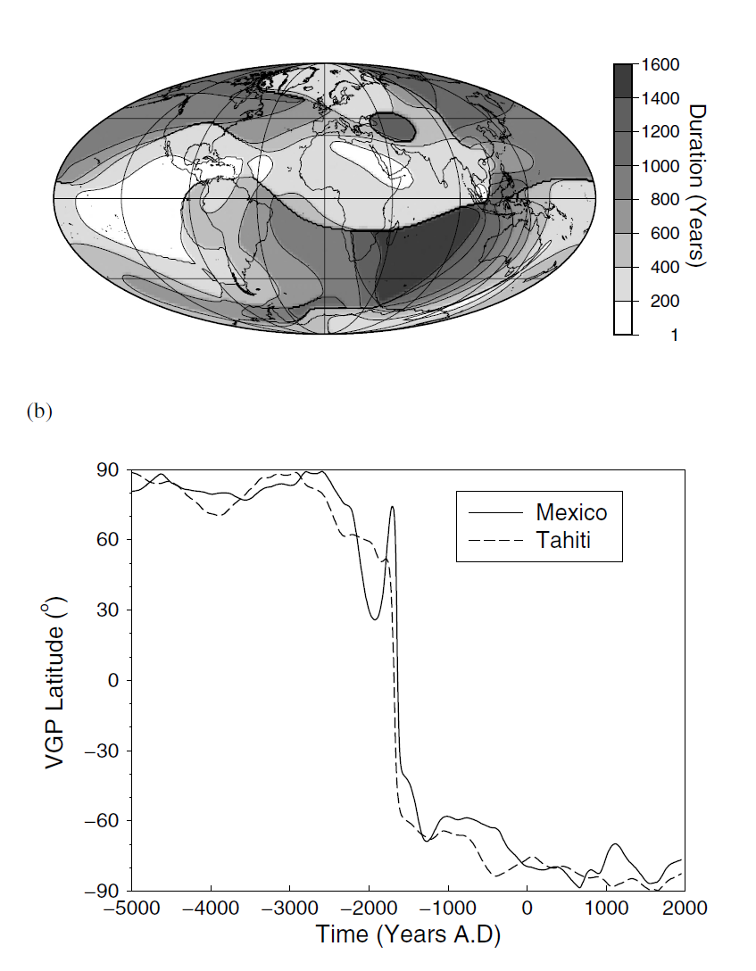
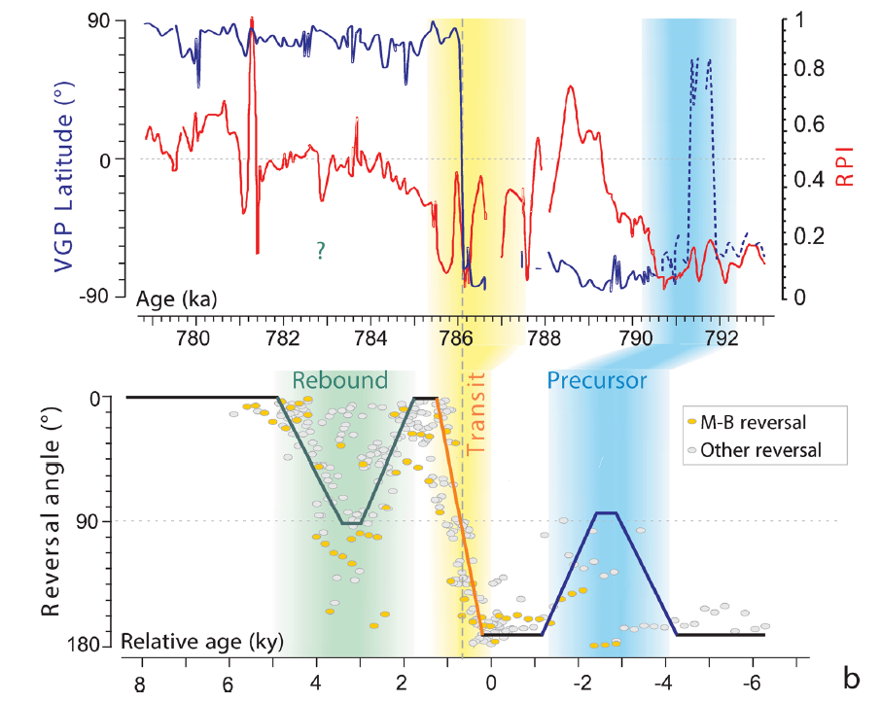
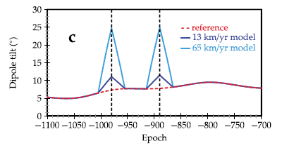
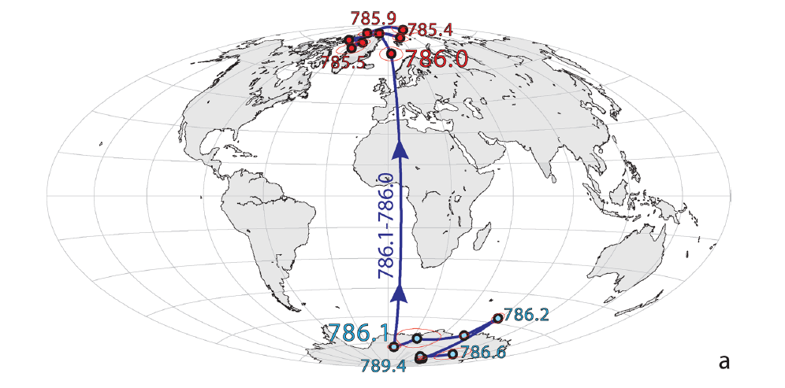
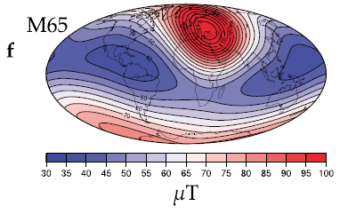
Rapid Directional Changes
Sagnotti et al (2014)
Fournier et al (2015)
Brown et al (2007)
Intensity
Rapid directional changes of $\sim 1^{∘}$/yr have been obtained, but are debated
Notes:
Fournier 15 had rapid dirn changes
Archeo jerks?

Slide 3
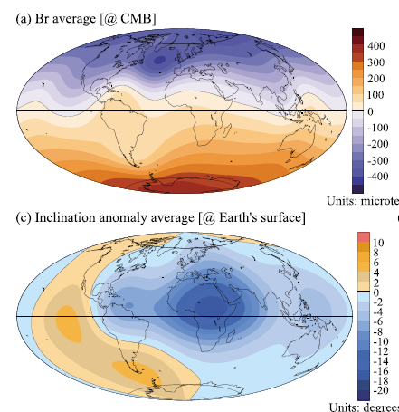
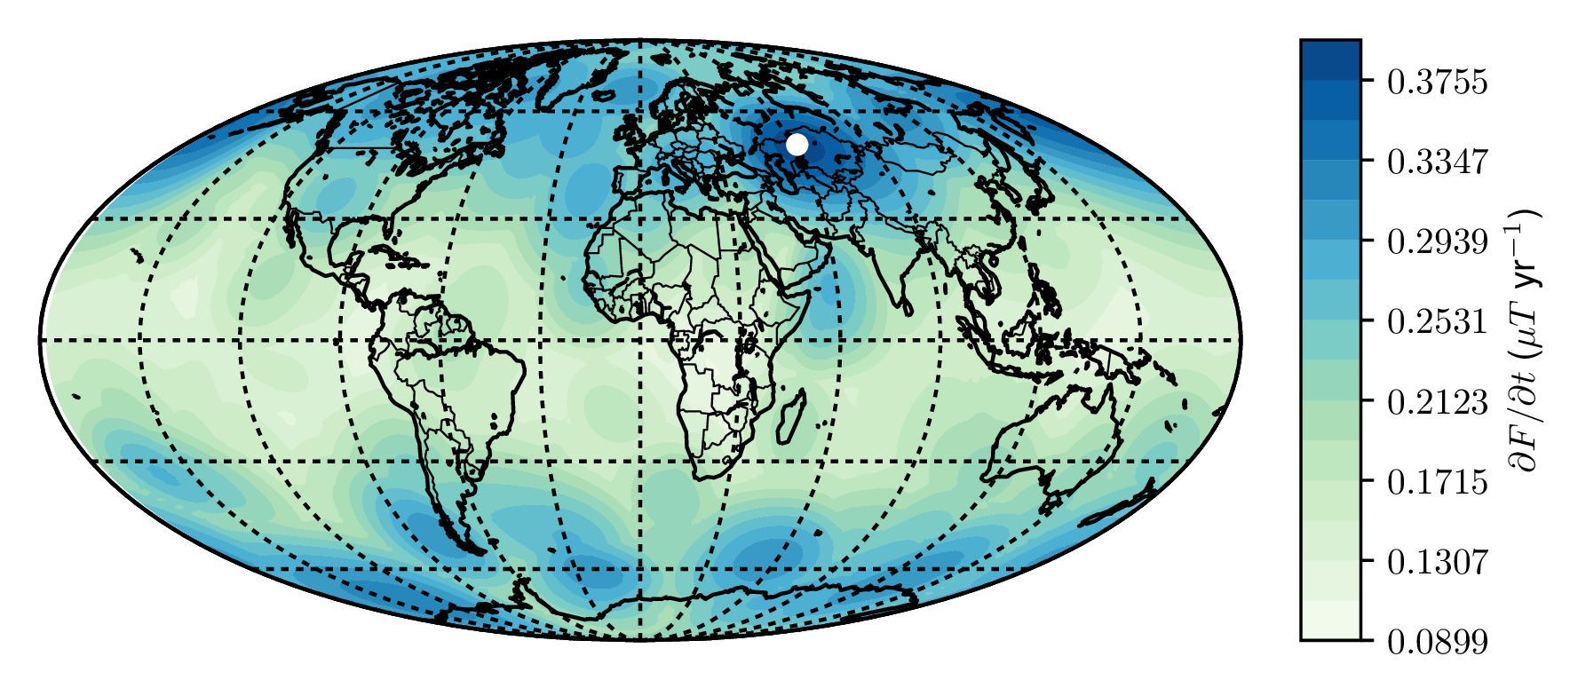
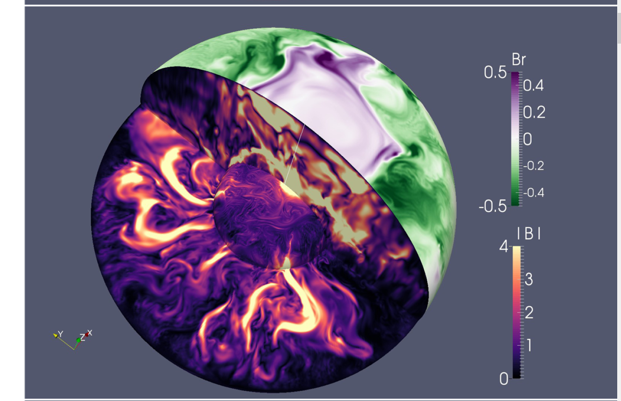
New Global Field Models and Simulations
Davies and Constable (2018)
GGF100k (Panovska et al, 2018) [Also LSMOD, Brown et al (2018)]
Schaeffer et al (2017)
Notes:
Should put dynamos here

Slide 4
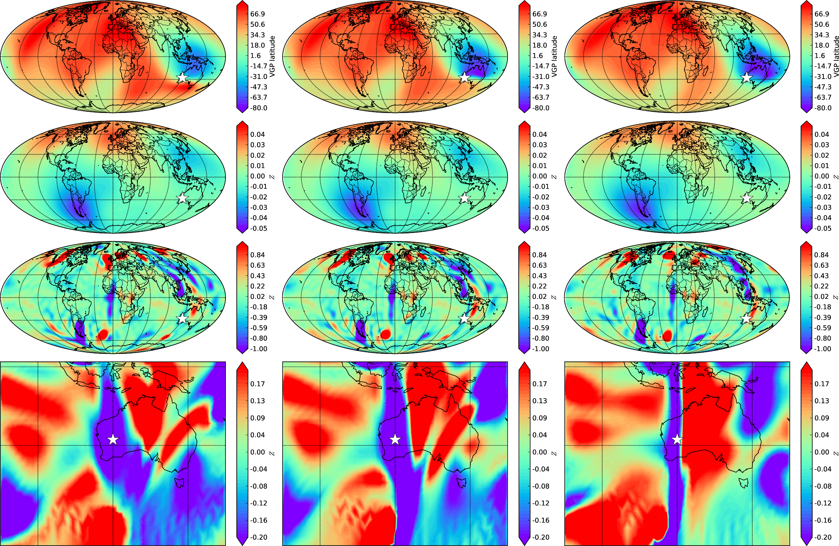
Objectives
Use numerical dynamo simulations and GGF100k to investigate directional changes at Earth’s surface:
How fast can the geomagnetic field change direction?
Where are the fastest changes located?
Use numerical simulations to investigate:
Core processes that are responsible for these changes
Maximum Rate of change of Pole Position in GGF100k
CMB field in dynamo simulation
Notes:
MGS obtained first field measurements below ionosphere – crucial as fields at and above this level can be strong and confused with fields of internal origin (Acuna et al 99).
Field is low over impact craters, suggesting it had terminated by the time these features formed, ~4Ga (Acuna et al 99; lillis et al 08)
Anomalies are in southern highlands.
Weiss et al 02 suggest dynamo was operating before 4 Ga.
Using this info gives insight into structure dynamics and evolution of Martian interior.

Slide 5
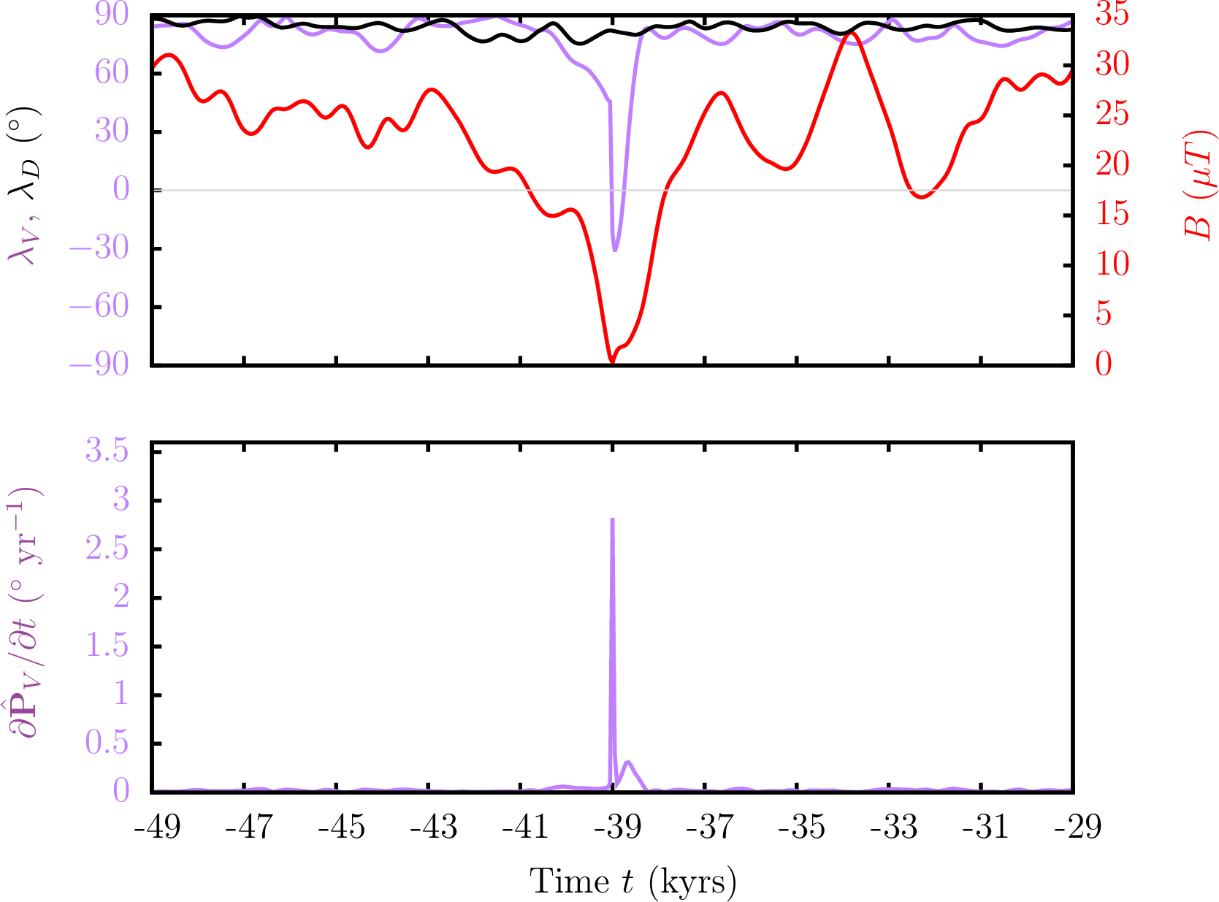
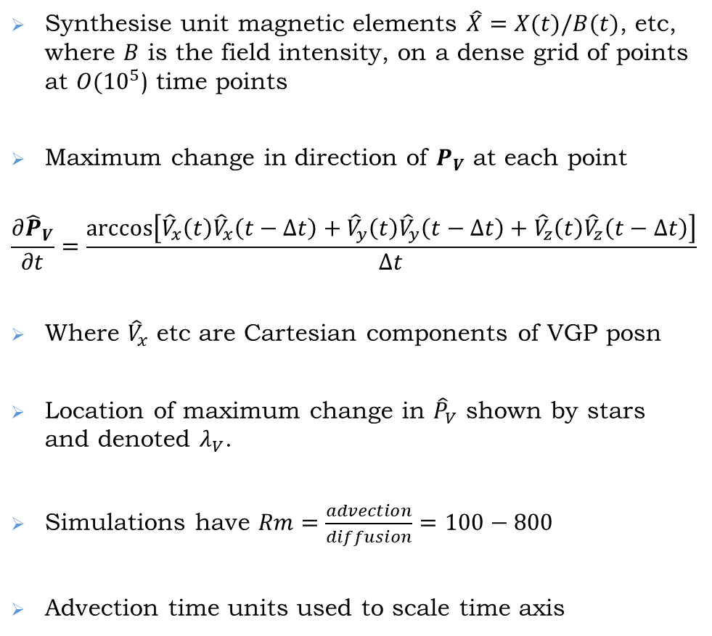
Rapid Changes in Dynamo Simulations
Synthesise unit magnetic elements $\hat{X}=X(t)/B(t)$, etc, where $B$ is the field intensity, on a dense grid of points at $O({10}^{5}$) time points
Maximum change in direction of $P_{V}$ at each point
$$\frac{∂{\hat{P}}_{V}}{∂t}=\frac{arccos\left[{\hat{V}}_{x}\left(t\right){\hat{V}}_{x}\left(t−Δt\right)+{\hat{V}}_{y}\left(t\right){\hat{V}}_{y}\left(t−Δt\right)+{\hat{V}}_{z}\left(t\right){\hat{V}}_{z}\left(t−Δt\right)\right]}{Δt}$$
Where ${\hat{V}}_{x}$ etc are Cartesian components of VGP posn
Location of maximum change in ${\hat{P}}_{V}$ shown by stars and denoted $λ_{V}$.
Simulations have $Rm=\frac{advection}{diffusion}=100−800$
Advection time units used to scale time axis
Notes:
Note that sims ran with different control params, BC’s etc

Slide 6
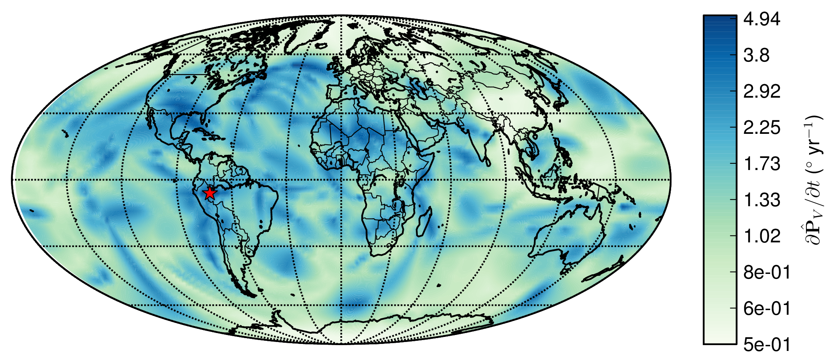
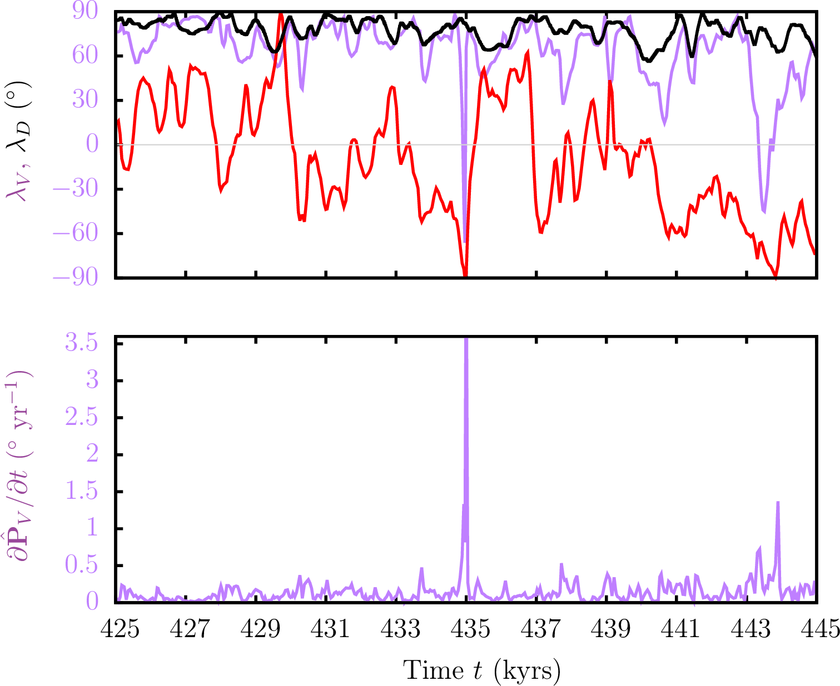
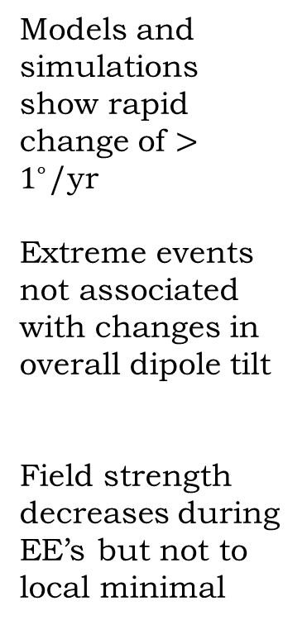
Rapid Changes in Model (Left) and GGF100k (Right)
“Extreme event”
Models and simulations show rapid change of $>1^{∘}$/yr
Extreme events not associated with changes in overall dipole tilt
Field strength decreases during EE’s but not to local minimal
Notes:
Sims run for longer hence greater range of events

Slide 7
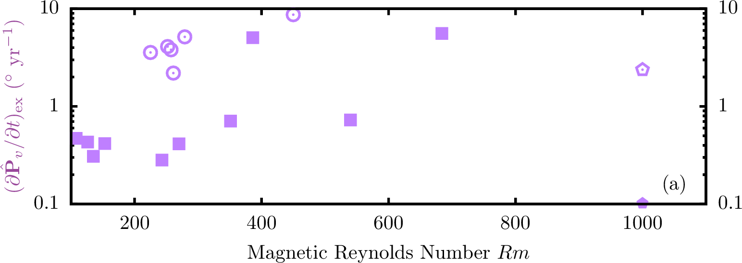
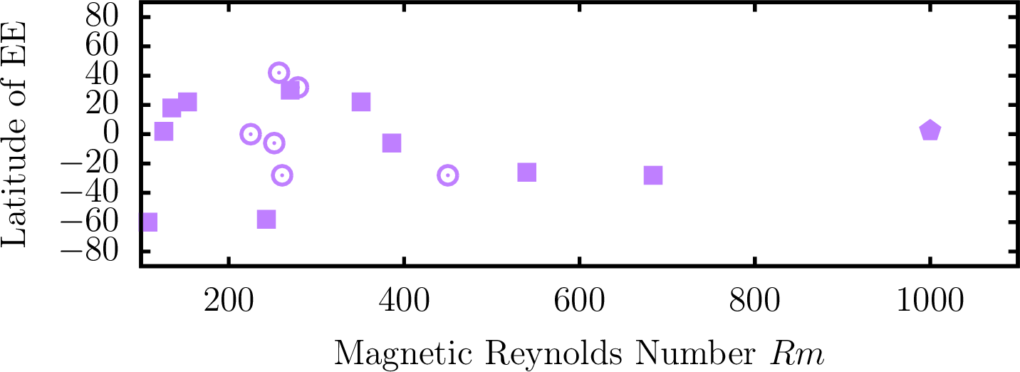
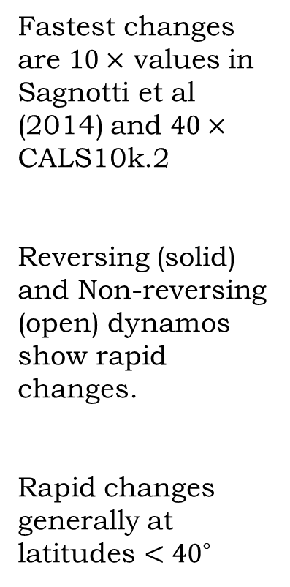
Amplitudes and Locations of Extreme Changes
GGF100k
Fastest changes are $10×$ values in Sagnotti et al (2014) and $40×$ CALS10k.2
Reversing (solid) and Non-reversing (open) dynamos show rapid changes.
Rapid changes generally at latitudes $<{40}^{∘}$
CALS10k.2b
Notes:
MGS obtained first field measurements below ionosphere – crucial as fields at and above this level can be strong and confused with fields of internal origin (Acuna et al 99).
Field is low over impact craters, suggesting it had terminated by the time these features formed, ~4Ga (Acuna et al 99; lillis et al 08)
Anomalies are in southern highlands.
Weiss et al 02 suggest dynamo was operating before 4 Ga.
Using this info gives insight into structure dynamics and evolution of Martian interior.

Slide 8
Statistics of Extreme Changes
Angular rates of change are approx log-normally distributed.
Peak values range up to 22.5 deg/ year for high resolution LSMOD.2
Highest rates of change occur at low latitudes, with generally lower rates at high latitudes
GGF100k, 99th percentile
at .054 deg/yr
LSMOD.2, 99th percentile
at .405 deg/yr
Notes:
Histograms of angular rates of changes for GGF100k, LSMOD.2 (covering 50-30Ka and Laschamp). Note higher resolution for LSMOD.2 gives almost order of magnitude increase in peak rate of change, and 99th percentile of the distribution..
Note log scales for CDFs. For simulation 95th percentile is .336 deg/yr – comparable to LSMOD.2
All distributions show more variability at low latitude than high latitude.

Slide 9
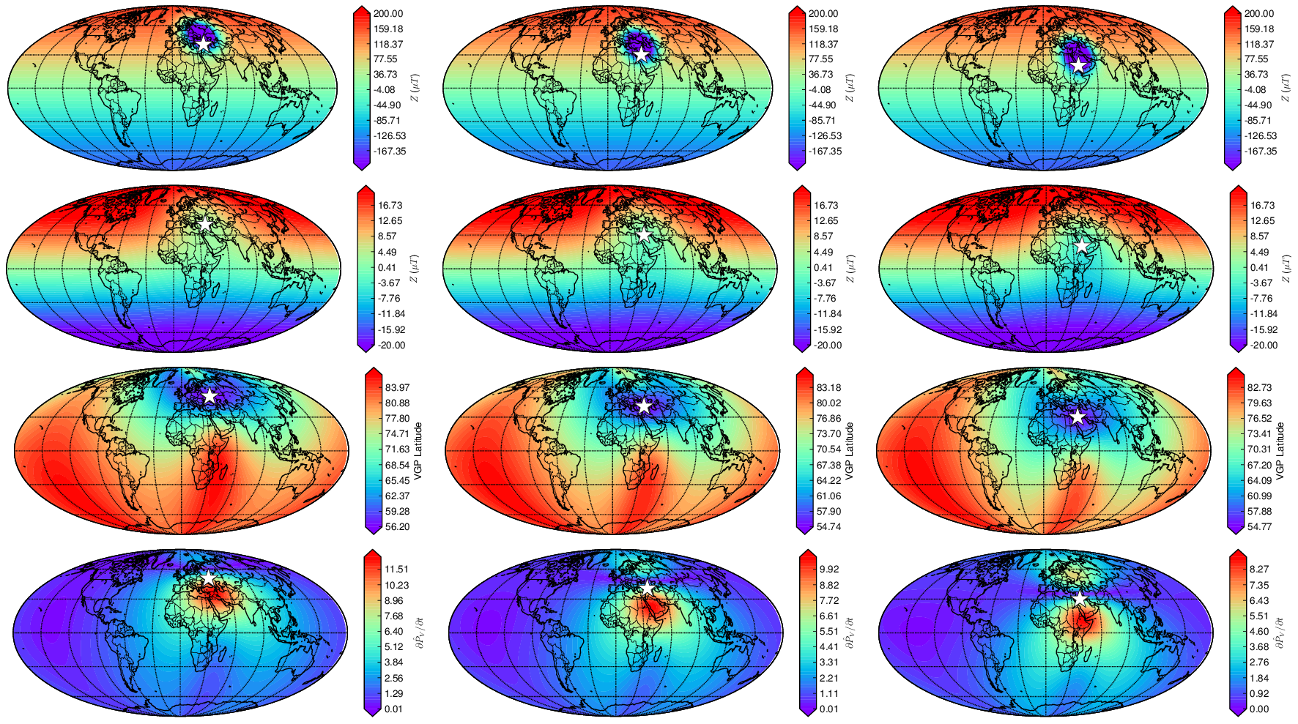
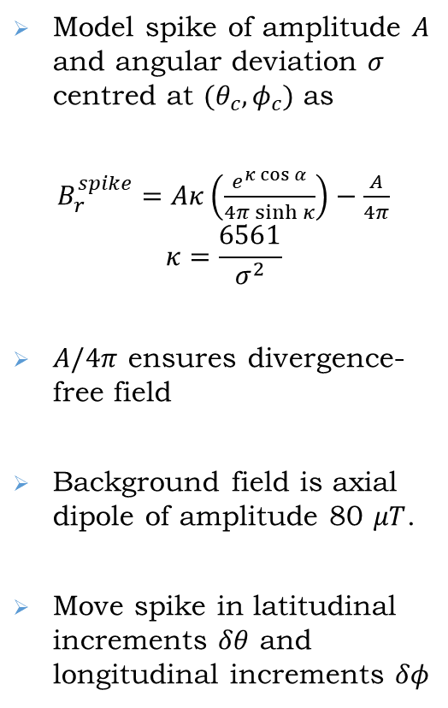
Toy Model of Rapid Directional Changes
Time
Model spike of amplitude $A$ and angular deviation $σ$ centred at $(θ_{c},φ_{c})$ as
$B_{r}^{spike}=Aκ\left(\frac{e^{κ\cos{α}}}{4π\sinh{κ}}\right)−\frac{A}{4π}$
$$κ=\frac{6561}{σ^{2}}$$
$A/4π$ ensures divergence-free field
Background field is axial dipole of amplitude 80 $μT$.
Move spike in latitudinal increments $δθ$ and longitudinal increments $δφ$
Based on model by Davies and Constable, Nat Comms, 2017
Notes:
We assigned an uncertainty to the spike age of ±100 years, which is similar to the age uncertainty on the Jordanian data and to the average age uncertainty of the paleointensity data used to construct CALS10k.2. We then selected all absolute intensity data from the Geomagia.v3 database¹⁷ with assigned ages in the range 1000±150 BC, yielding 143 data in 23 locations. Data without any prescribed age uncertainty were assigned the average value from the CALS10k.2 paleointensity data, namely σ_{age}=110 years (Fig. 3a).
The overall intensity uncertainty was assumed to arise from three factors (Methods): intensity uncertainty as a product of the laboratory measurements, σ_{lab}; age uncertainty based on dating the sample, σ_{age}; and age difference, Δ, between the sample age and the time of the spike, taken to be 1000 BC.
Since models with minimum L¹ (and L²) are too smooth to fit the high-intensity Near East data we also require that a suitable model fits the observed intensity at the location of the spike, initially taken to be Israel.

Slide 10
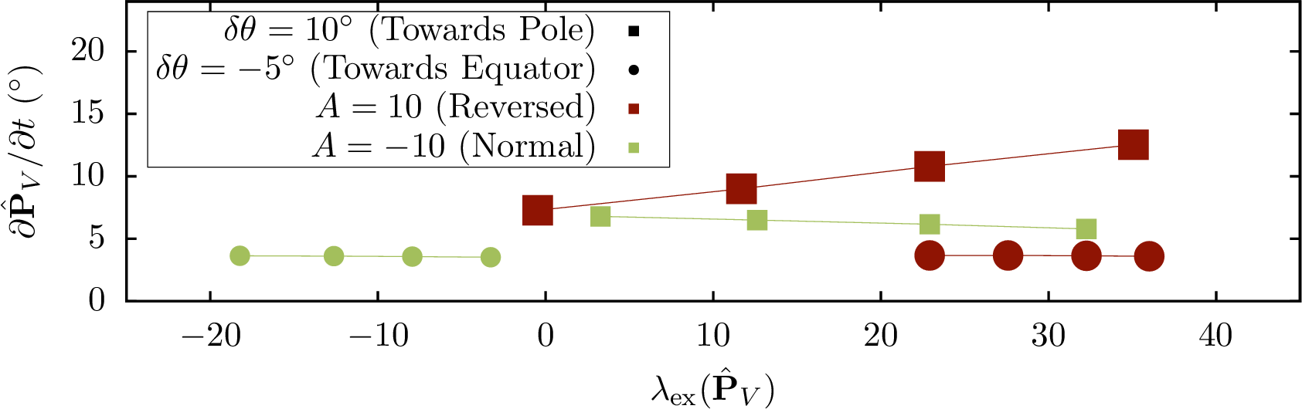
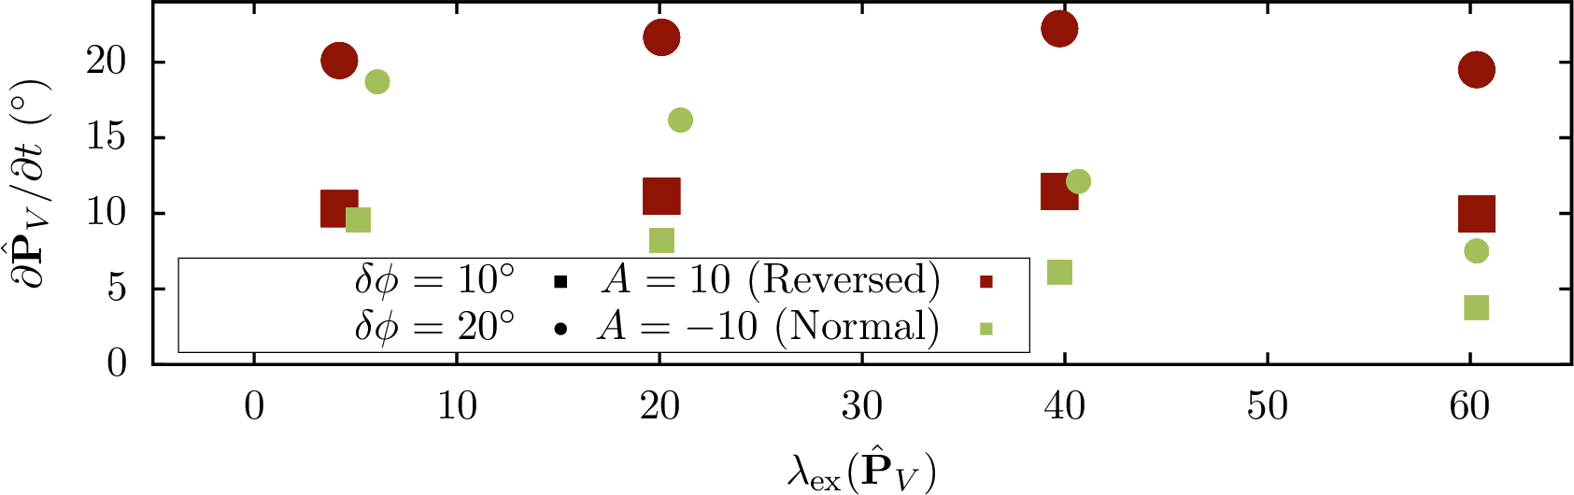
Toy Model of Rapid Directional Changes
Isolated Reversed flux patches (red) always produce greater directional changes than the equivalent normal flux patch
…
What about many reversed and normal patches?
Notes:
We assigned an uncertainty to the spike age of ±100 years, which is similar to the age uncertainty on the Jordanian data and to the average age uncertainty of the paleointensity data used to construct CALS10k.2. We then selected all absolute intensity data from the Geomagia.v3 database¹⁷ with assigned ages in the range 1000±150 BC, yielding 143 data in 23 locations. Data without any prescribed age uncertainty were assigned the average value from the CALS10k.2 paleointensity data, namely σ_{age}=110 years (Fig. 3a).
The overall intensity uncertainty was assumed to arise from three factors (Methods): intensity uncertainty as a product of the laboratory measurements, σ_{lab}; age uncertainty based on dating the sample, σ_{age}; and age difference, Δ, between the sample age and the time of the spike, taken to be 1000 BC.
Since models with minimum L¹ (and L²) are too smooth to fit the high-intensity Near East data we also require that a suitable model fits the observed intensity at the location of the spike, initially taken to be Israel.

Slide 11
Origin of Rapid Directional Changes
Time
Location of fastest directional change
Surface
Surface
CMB
CMB
Reversed flux

Slide 12
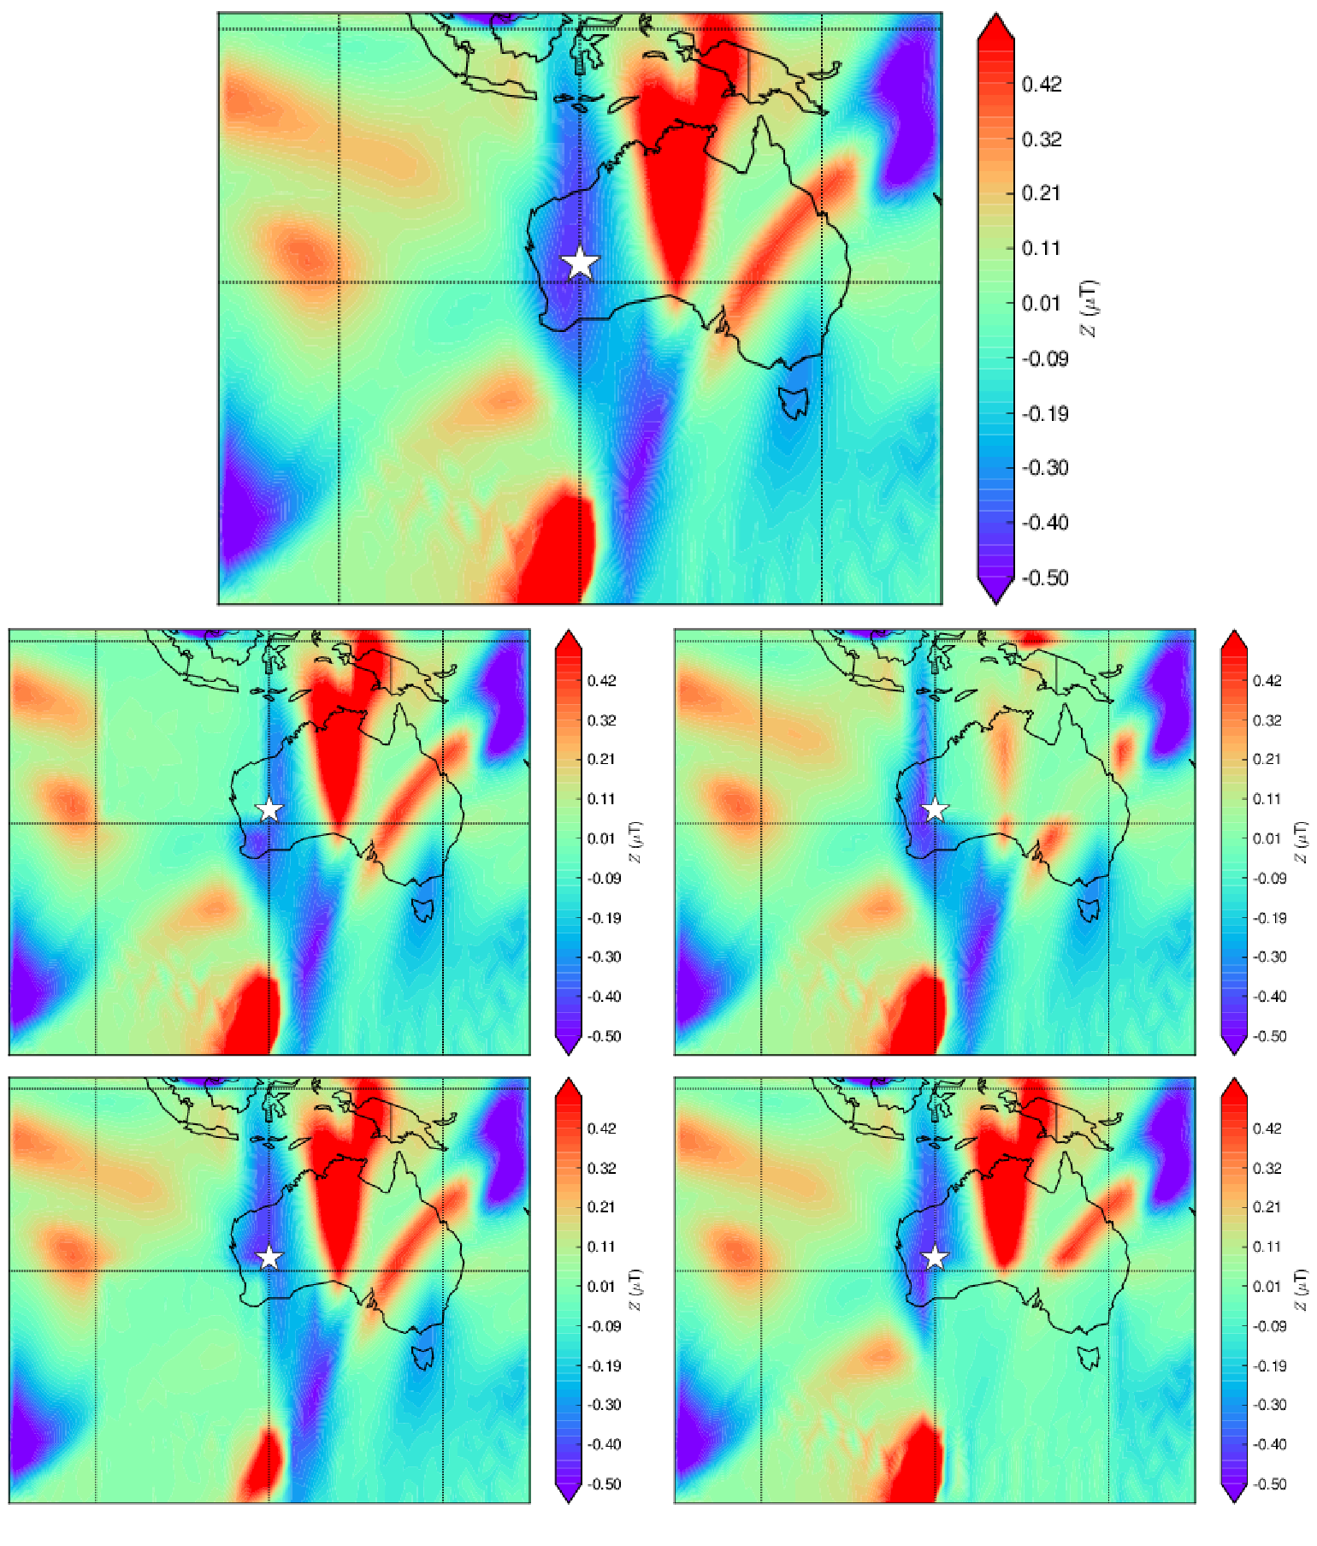
Masking Features of CMB Field
Northwest (NW) quadrant
Northeast (NE) quadrant
Southwest (SW) quadrant
Southeast (SE) quadrant
Mask NW
Mask NE
Mask SW
Mask SE
Notes:
We assigned an uncertainty to the spike age of ±100 years, which is similar to the age uncertainty on the Jordanian data and to the average age uncertainty of the paleointensity data used to construct CALS10k.2. We then selected all absolute intensity data from the Geomagia.v3 database¹⁷ with assigned ages in the range 1000±150 BC, yielding 143 data in 23 locations. Data without any prescribed age uncertainty were assigned the average value from the CALS10k.2 paleointensity data, namely σ_{age}=110 years (Fig. 3a).
The overall intensity uncertainty was assumed to arise from three factors (Methods): intensity uncertainty as a product of the laboratory measurements, σ_{lab}; age uncertainty based on dating the sample, σ_{age}; and age difference, Δ, between the sample age and the time of the spike, taken to be 1000 BC.
Since models with minimum L¹ (and L²) are too smooth to fit the high-intensity Near East data we also require that a suitable model fits the observed intensity at the location of the spike, initially taken to be Israel.

Slide 13
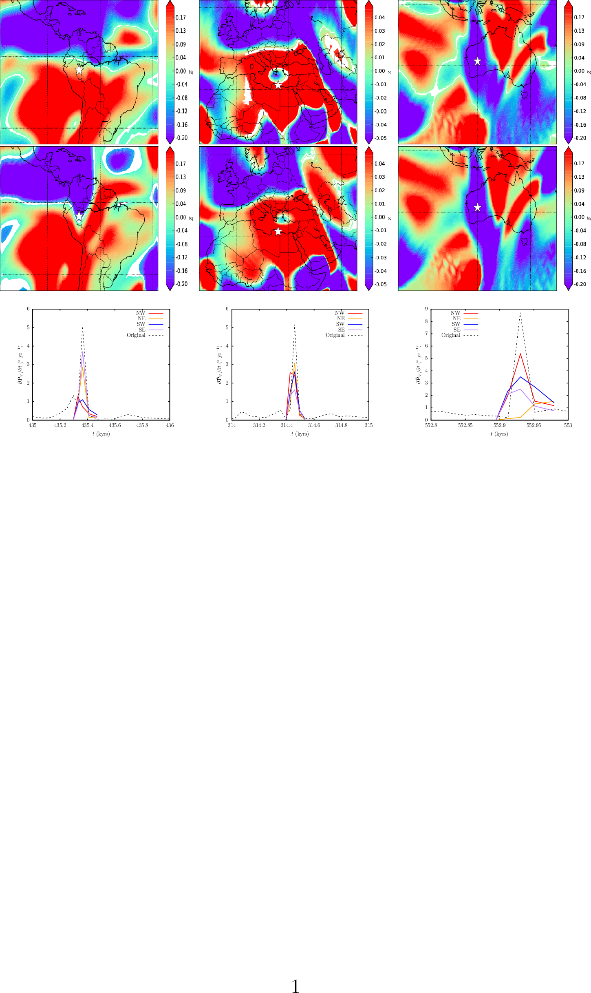
Origin of Rapid Directional Changes
Time
CMB field
Reversed flux
Greatest reduction in rate of directional change occurs when reversed patch in NE quadrant is masked.
Extreme event
Notes:
We assigned an uncertainty to the spike age of ±100 years, which is similar to the age uncertainty on the Jordanian data and to the average age uncertainty of the paleointensity data used to construct CALS10k.2. We then selected all absolute intensity data from the Geomagia.v3 database¹⁷ with assigned ages in the range 1000±150 BC, yielding 143 data in 23 locations. Data without any prescribed age uncertainty were assigned the average value from the CALS10k.2 paleointensity data, namely σ_{age}=110 years (Fig. 3a).
The overall intensity uncertainty was assumed to arise from three factors (Methods): intensity uncertainty as a product of the laboratory measurements, σ_{lab}; age uncertainty based on dating the sample, σ_{age}; and age difference, Δ, between the sample age and the time of the spike, taken to be 1000 BC.
Since models with minimum L¹ (and L²) are too smooth to fit the high-intensity Near East data we also require that a suitable model fits the observed intensity at the location of the spike, initially taken to be Israel.

Slide 14
Origin of Rapid Directional Changes
Time
CMB field
Reversed flux
Greatest amplitude reduction for all extreme events considered arises when reversed flux is masked in the CMB field
Extreme event
Notes:
We assigned an uncertainty to the spike age of ±100 years, which is similar to the age uncertainty on the Jordanian data and to the average age uncertainty of the paleointensity data used to construct CALS10k.2. We then selected all absolute intensity data from the Geomagia.v3 database¹⁷ with assigned ages in the range 1000±150 BC, yielding 143 data in 23 locations. Data without any prescribed age uncertainty were assigned the average value from the CALS10k.2 paleointensity data, namely σ_{age}=110 years (Fig. 3a).
The overall intensity uncertainty was assumed to arise from three factors (Methods): intensity uncertainty as a product of the laboratory measurements, σ_{lab}; age uncertainty based on dating the sample, σ_{age}; and age difference, Δ, between the sample age and the time of the spike, taken to be 1000 BC.
Since models with minimum L¹ (and L²) are too smooth to fit the high-intensity Near East data we also require that a suitable model fits the observed intensity at the location of the spike, initially taken to be Israel.

Slide 15
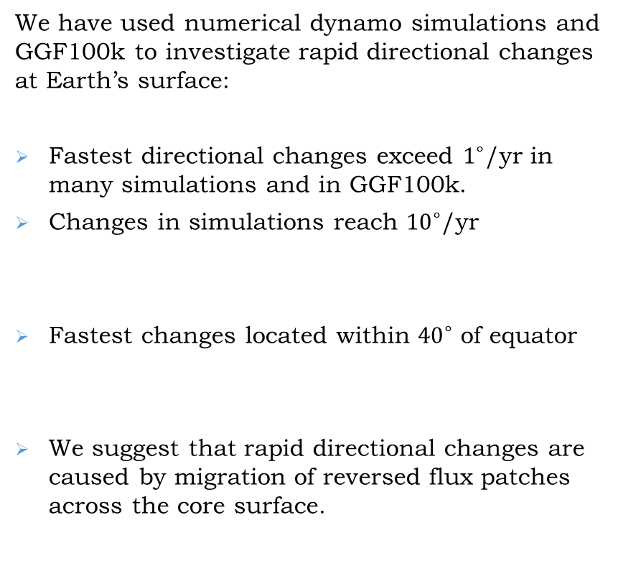
Conclusions
We have used numerical dynamo simulations and GGF100k to investigate rapid directional changes at Earth’s surface:
Fastest directional changes exceed $1^{∘}$/yr in many simulations and in GGF100k.
Changes in simulations reach ${10}^{∘}$/yr
Fastest changes located within ${40}^{∘}$ of equator
We suggest that rapid directional changes are caused by migration of reversed flux patches across the core surface.
Maximum Rate of change of Pole Position in GGF100k
Notes:
Fastest changes are compatible with physics of the dynamo process

Slide 16
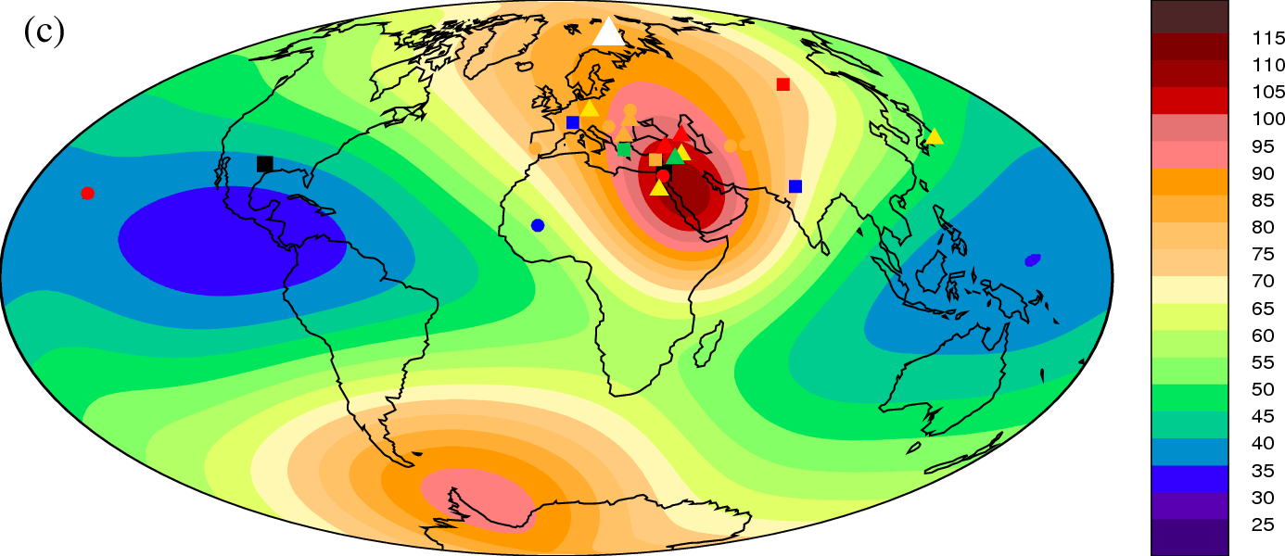
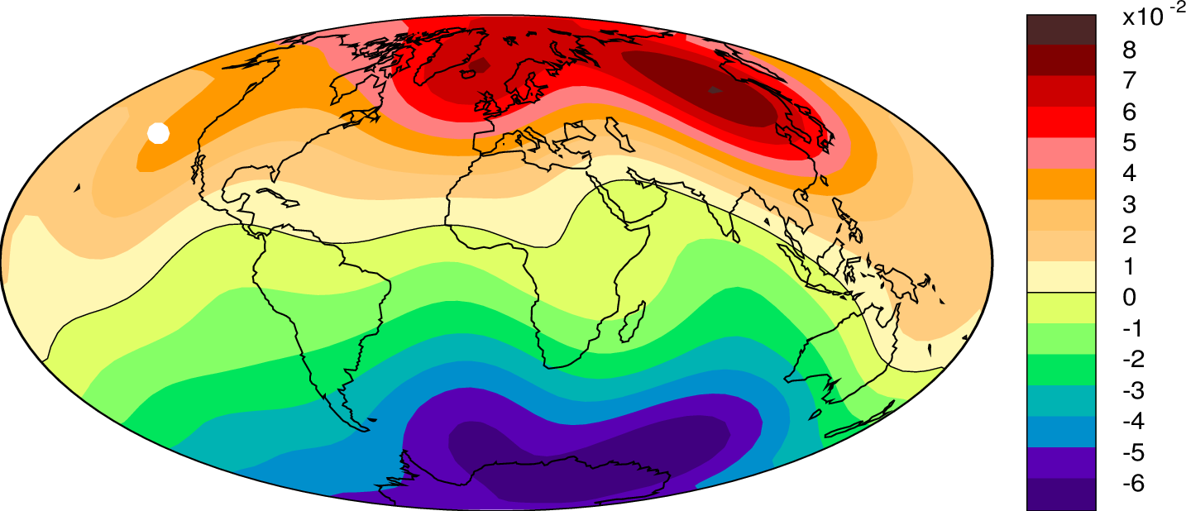
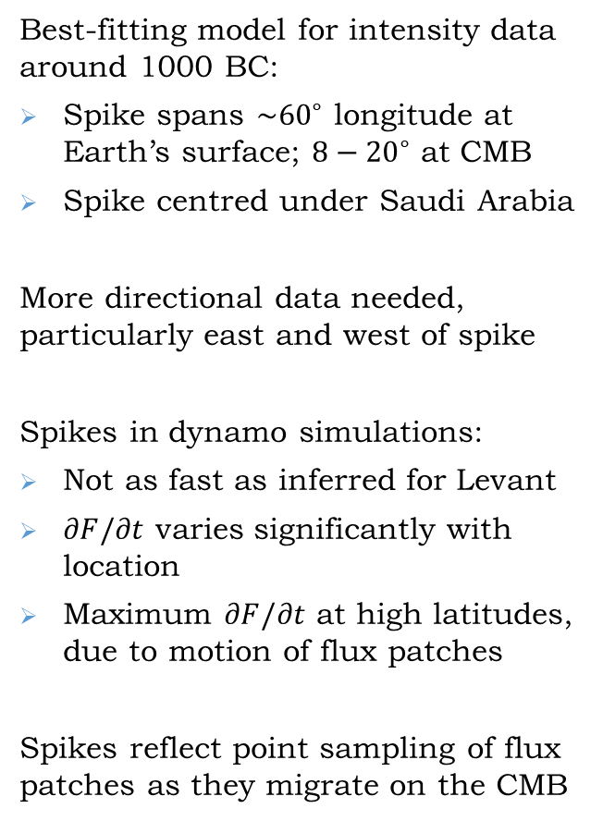
Conclusions
Best-fitting model for intensity data around 1000 BC:
Spike spans $\sim {60}^{∘}$ longitude at Earth’s surface; $8−{20}^{∘}$ at CMB
Spike centred under Saudi Arabia
More directional data needed, particularly east and west of spike
Spikes in dynamo simulations:
Not as fast as inferred for Levant
$∂F/∂t$ varies significantly with location
Maximum $∂F/∂t$ at high latitudes, due to motion of flux patches
Spikes reflect point sampling of flux patches as they migrate on the CMB
Davies & Constable, Nat. Comms. (2017)
Davies & Constable (In prep)
Notes:
MGS obtained first field measurements below ionosphere – crucial as fields at and above this level can be strong and confused with fields of internal origin (Acuna et al 99).
Field is low over impact craters, suggesting it had terminated by the time these features formed, ~4Ga (Acuna et al 99; lillis et al 08)
Anomalies are in southern highlands.
Weiss et al 02 suggest dynamo was operating before 4 Ga.
Using this info gives insight into structure dynamics and evolution of Martian interior.

Slide 17
Thank You
Notes:
MGS obtained first field measurements below ionosphere – crucial as fields at and above this level can be strong and confused with fields of internal origin (Acuna et al 99).
Field is low over impact craters, suggesting it had terminated by the time these features formed, ~4Ga (Acuna et al 99; lillis et al 08)
Anomalies are in southern highlands.
Weiss et al 02 suggest dynamo was operating before 4 Ga.
Using this info gives insight into structure dynamics and evolution of Martian interior.

Slide 18
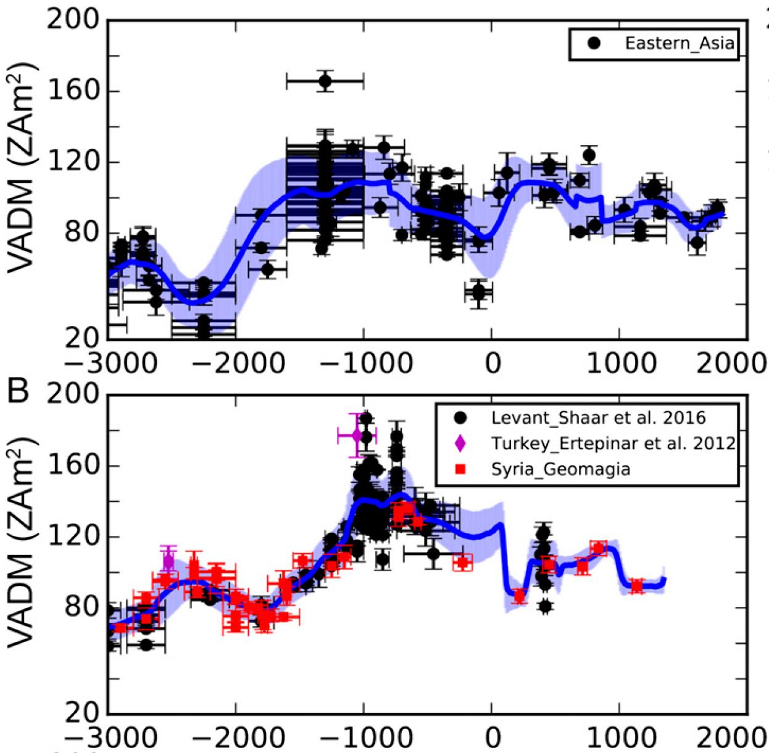
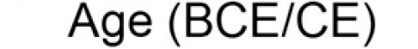
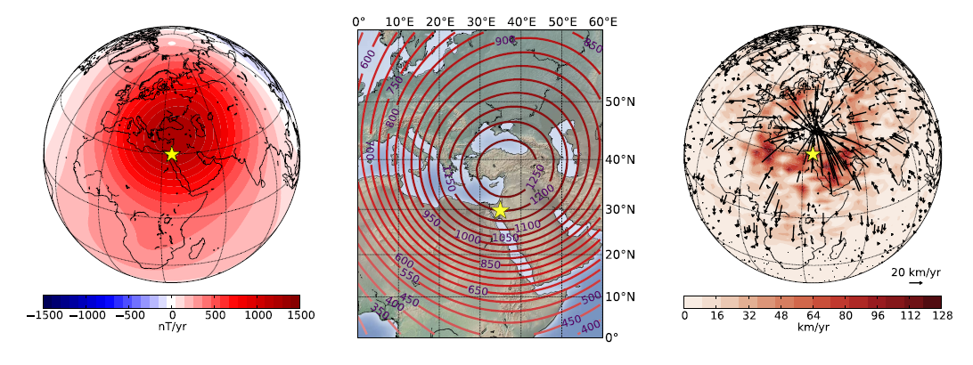
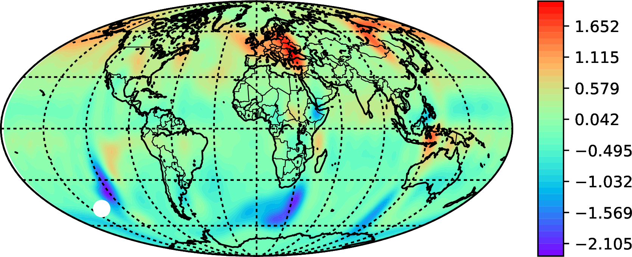

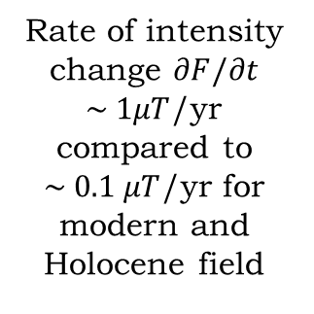


Rapid Intensity Changes
Levant
Eastern Asia
Rate of intensity change $∂F/∂t$ $\sim 1μT$/yr compared to $\sim 0.1 μT$/yr for modern and Holocene field
Cai et al (2016)
$$∂F/∂t$$
$$|u|$$
$B_{r}$ (CMB)
Spikes associated with rapid core flows and migration of normal flux patches across core surface
Livermore et al (2014)
Davies and Constable, EPSL (2018)

Slide 19
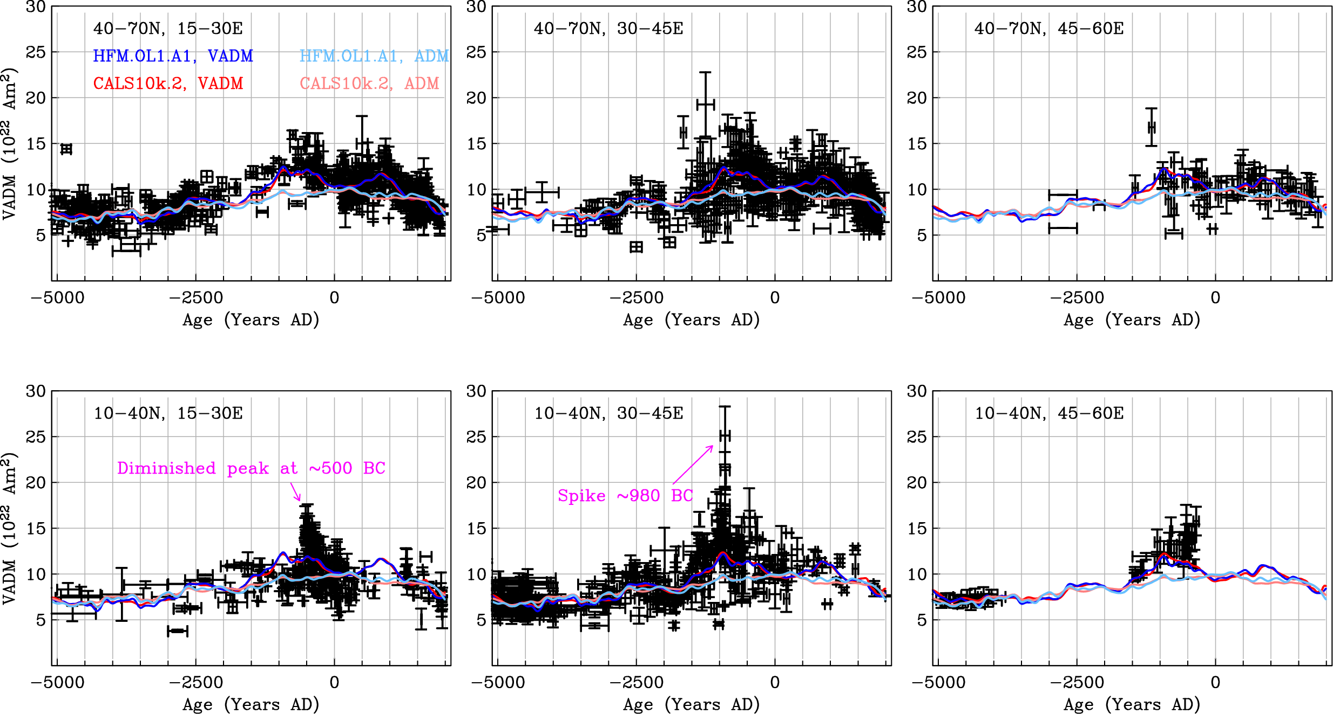
Global or Region Feature
Davies & Constable (2017)
Data from Geomagia (Brown et al, 2015)
Spike is clearly visible in the 10–40° N, 30–45° E geographic bin but not elsewhere
Notes:
MGS obtained first field measurements below ionosphere – crucial as fields at and above this level can be strong and confused with fields of internal origin (Acuna et al 99).
Field is low over impact craters, suggesting it had terminated by the time these features formed, ~4Ga (Acuna et al 99; lillis et al 08)
Anomalies are in southern highlands.
Weiss et al 02 suggest dynamo was operating before 4 Ga.
Using this info gives insight into structure dynamics and evolution of Martian interior.

Slide 20
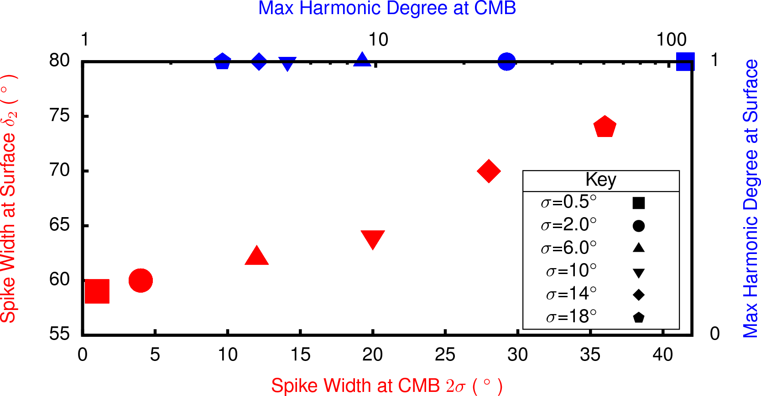
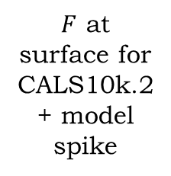
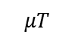
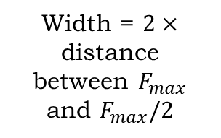
A Model Levantine Spike
$$μT$$
Symbols:
1150–1050 BC (triangles)
1049–950 BC (squares)
949–850 BC (circles)
$F$ at surface for CALS10k.2 + model spike
Width = $2×$ distance between $F_{max}$ and $F_{max}/2$
Davies & Constable (2017)
Notes:
The estimates presented in Supplementary Table 1indicate that total uncertainties exceeding 45% of the measurement (with ∂F/∂t=0.2 μT yr⁻¹) pertain to data from Japan, Mali, Czech Republic, India, Greece, Syria and Egypt. It is tempting to remove these data, since this would all but resolve the inconsistencies in the Near East shown in Fig. 4.
The present root mean square (RMS) CMB field strength, , including the small scales, can be inferred using numerical geodynamo simulations²⁸ and studies of Earth’s nutations^{29,30} and length-of-day variations³¹, and may be as large as 1 mT. Assuming a similar value around 1000 BC eliminates only the very thin spikes: all models with σ≥4° and A≤600 mT have <1.7 mT.

Slide 21
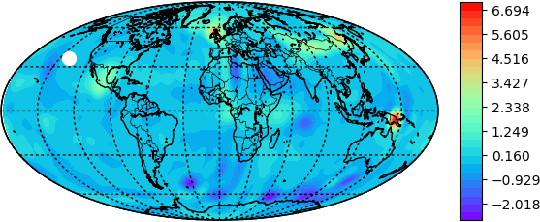
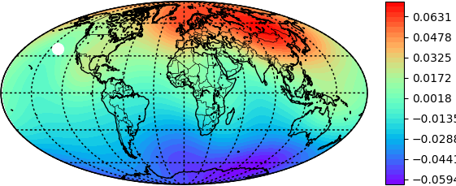
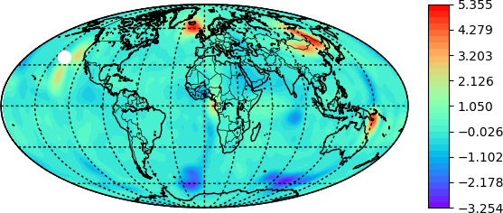
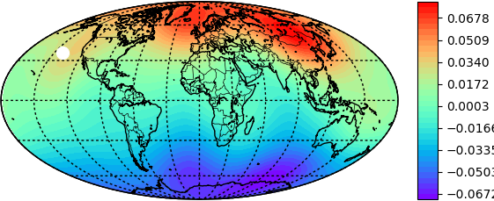
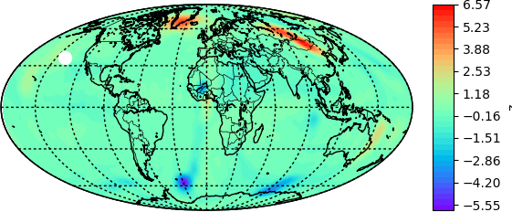
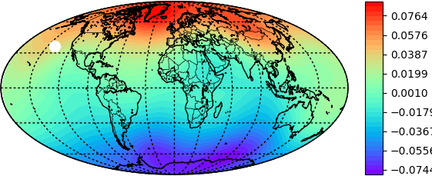
Spike Evolution

